Slide 1
Tree
A tree, is a finite set of nodes together with a finite set of directed edges that define parent-child relationships. Each directed edge connects a parent to its child. Example:
Nodes={A,B,C,D,E,FG,H}
Edges={(A,B),(A,E),(B,F),(B,G),(B,H),
(E,C),(E,D)}
A
E
B
D
C
F
H
G

Slide 2
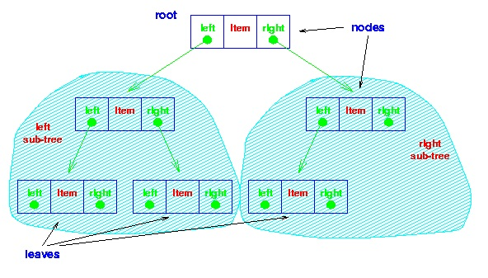
The simplest form of tree is a binary tree. A binary tree consists of a node (called the root node) and left and right sub-trees.
Both the sub-trees are themselves binary trees.

Slide 3
A tree satisfies the following properties:
It has one designated node, called the root, that has no parent.
Every node, except the root, has exactly one parent.
A node may have zero or more children.
There is a unique directed path from the root to each node.
5
5
3
2
3
2
4
1
6
4
1
6
tree
Not a tree

Slide 4
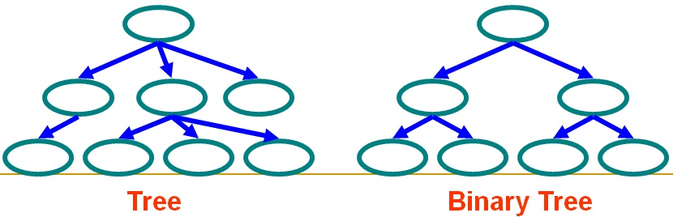
Tree vs Binary Tree

Slide 5
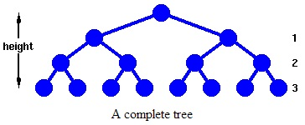
Number of nodes at each level? n=1,2,4,8,16… n=2^0 , 2^1 , 2^2 , 2^3 , 2^4 ,…2^h Total Number of nodes? n=1+2+4+8+… n=2^(h+1) -1
Binary Tree

Slide 6
Root Node
Node at the "top" of a tree - the one from which all operations on the tree commence. The root node may not exist (a NULL tree with no nodes in it) or have 0, 1 or 2 children in a binary tree.
Leaf Node
Node at the "bottom" of a tree - farthest from the root. Leaf nodes have no children.
Siblings
Two nodes that have the same parent are called siblings
Parent
Child
Ancestors
Descendants
Complete Tree
Tree in which each leaf is at the same distance from the root. (For now)
Height
Number of nodes which must be traversed from the root to reach a leaf of a tree.

Slide 7
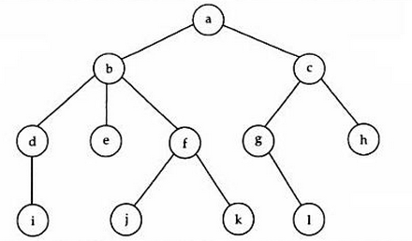
The nodes that are directly accessible from a node are called children of that node.
d,e and f are children of b
b is the parent of d,e and f
d,e and f are siblings (common parent)
e, g, h, j, l are leaves
b is an ancestor of i, j, k
i,j,k are descendants of b
Note: If there is a path from node1 to node2, node1 is the ancestor of node2 and node2 is the descendant of node1.
Note: A node is also called ancestor and descendant of itself. So, when the ancestor and descendants are different than the node itself, they are called proper ancestors and proper descendants.

Slide 8
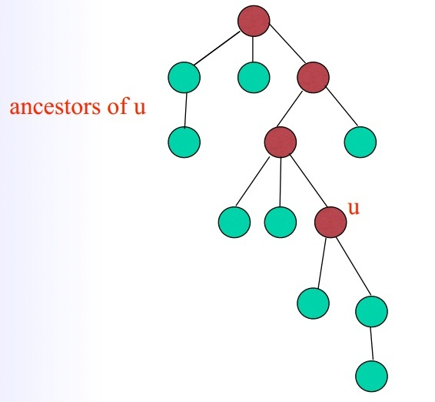
Ancestors

Slide 9
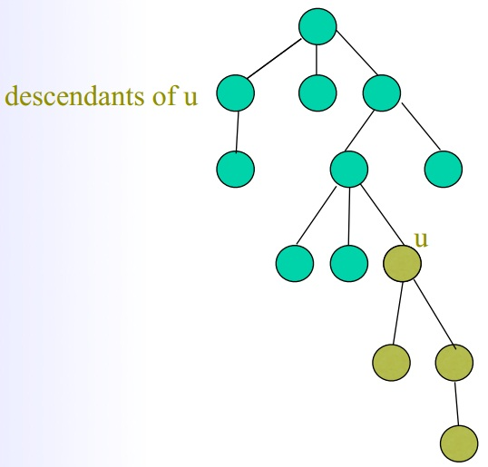

Slide 10
The depth of root is 0
Depth of any node is the depth of its parent+1
Height of any tree is the maximum depth, i.e. the longest path from root to leaf (Or leaf to root).
Uncles
Grandfather
Grandchildren
Internal
External
Nodes with no children are called leaves, or external nodes. Nodes which are not leaves are called internal nodes.

Slide 11

Applications Useful in defining hierarchies Organizations, biology etc Decision Trees Binary Search

Slide 12
N-ary trees
Binary
ternary
Quarternary
.
.
.

Slide 13
Binary Tree formal definition
A binary tree is either empty (no nodes), or consists of a node called root which has two pointers to two different binary trees (left subtree and right subtree)

Slide 14
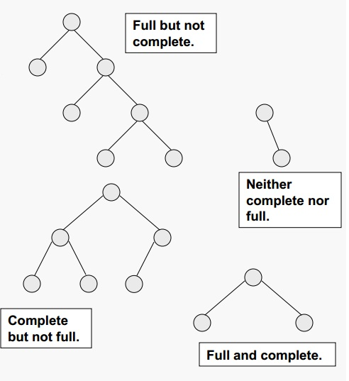
Binary Trees
A binary tree T is full if each node is either a leaf (0 child nodes) or possesses exactly two child nodes.
A binary tree T with n levels is complete if all levels except possibly the last are completely full, and the last level has all its nodes to the left side.

Slide 16
struct tree_node{
int data;
struct tree_node *left_child;
struct tree_node *right_child;
};

Slide 17
Traversing a Tree
General Definition: To traverse a data structure is to process, however you like, every node in the data structure exactly once.
Note: You may ``pass through'' a node as many times as you like but you must only “process the node once”.
Breadth first
Depth first

Slide 18
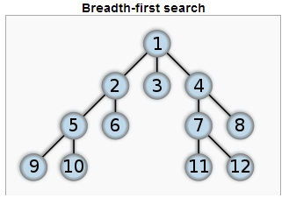
Breadth First
Level by Level

Slide 20
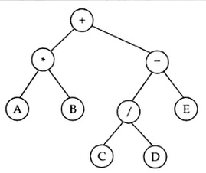

Slide 21
Traversing a Tree
Left-Node-Right -> Inorder traversal
Node-Left-Right -> Preorder traversal
Left-Right-Node -> Postorder traversal
Preorder Traversal => +*AB-/CDE
Inorder Traversal => A*B+C/D-E
Postorder Traversal => AB*CD/E-+

Slide 22
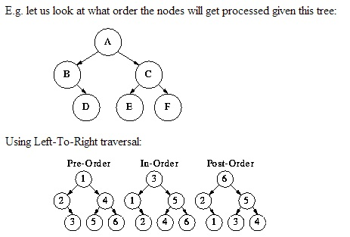
Traversing a Tree structure
Pre-Order Traversal-> do (N) before anything else.
Post-Order Traversal-> do (N) after everything else.
In-Order, or Infix Order, Traversal-> do (N) in between the two subtrees.

Slide 23
Pre-Order: A-B-D-C-E-F
In-Order: B-D-A-E-C-F
Post-Order: D-B-E-F-C-A

Slide 24
preorder(node)
if node == null then return
visit(node)
preorder(node.left)
preorder(node.right)
inorder(node)
if node == null then return
inorder(node.left)
visit(node)
inorder(node.right)
postorder(node)
if node == null then return
postorder(node.left)
postorder(node.right)
visit(node)

Slide 25
CODE | Traversal | Name
void preorderTraverse() { std::cout << " " << getValue(); if(LeftTree) { LeftTree->preorderTraverse(); } if(RightTree) { RightTree->preorderTraverse(); } } | Visit the node Visit the left subtree, if any. Visit the right subtree, if any. | Preorder (N-L-R)
void inorderTraverse() { if(LeftTree) { LeftTree->inorderTraverse(); } std::cout << " " << getValue(); if(RightTree) { RightTree->inorderTraverse(); } } | Visit the left subtree, if any. Visit the node Visit the right subtree, if any. | Inorder (L-N-R)
void postorderTraverse() { if(LeftTree) { LeftTree->postorderTraverse(); } if(RightTree) { RightTree->postorderTraverse(); } std::cout << " " << getValue(); } | Visit the left subtree, if any. Visit the right subtree, if any. Visit the node | Postorder (L-R-N)

Slide 26
References
Algorithms, Sedgewick and Wayne
Data Structures Using C, By Samir Kumar Bandyopadhya
http://www.bowdoin.edu/~ltoma/teaching/cs210/spring09/Slides/210-Trees.pdf
http://www.cs.ucf.edu/courses/cop3502h.02/trees1.pdf
http://courses.cs.vt.edu/~cs3114/Fall09/wmcquain/Notes/T03a.BinaryTreeTheorems.pdf

